Slide 1

UNIVERSITY OF PETROLEUM & ENERGY STUDIES
School of Computer Science
Dehradun
COURSE: Physical and IT Security
July – December 2023
Delivered
by
Dr. Gopal Singh Rawat

Slide 2
Course Plan
CO1. Introduction to Physical Security CO2. Approaches to Physical Security
CO3. Standards, Regulations and Guidelines
CO4. Fire and Fire Safety Inspection CO5. Vulnerability Assessment CO6. Security Surveys and Audit CO7. Security Lighting, Alarms
CO8. Video, Biometrics, Access Control, Fences CO09. Security Personnel
2

Slide 3
Chapter 3. Standards, Regulations, Guidelines

Slide 4
3.1 Physical Security Standards
Guidelines are regulated, best practices are required to be followed using Clauses and Controls
Main aim → prevention of assault on the facility of an organization
Follow Standards →
ISO 27002:2022
ISO 22301:2019
HIPPA
SOX
FIPS PUB 201-1
GLBA
3.1.1 ISO 27002:2022
Published by the International Organization for Standardization (ISO) and by the International Electrotechnical Commission (IEC)
“ Information security, cybersecurity and privacy protection — Information security controls.”
Relates to:
Establish guidelines and general principles for starting, implementing, maintaining and improving the management of Information Security in an organization.
This also includes selection, implementation and management of controls, taking into account the Risk Environments found in the company using Clauses and Controls.
ISO 27xxx series → Standard for Information Security

Slide 5
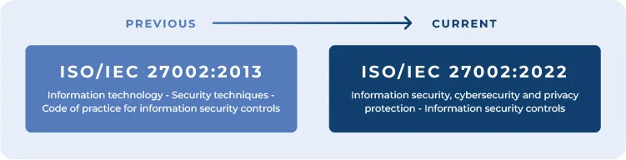
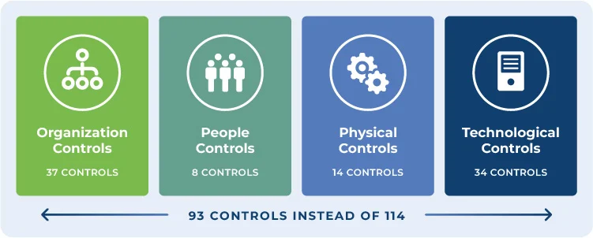
3.1 Physical Security Standards
3.1.1 ISO 27002:2022
Organizational controls
People controls
Physical controls
Technological controls

Slide 6
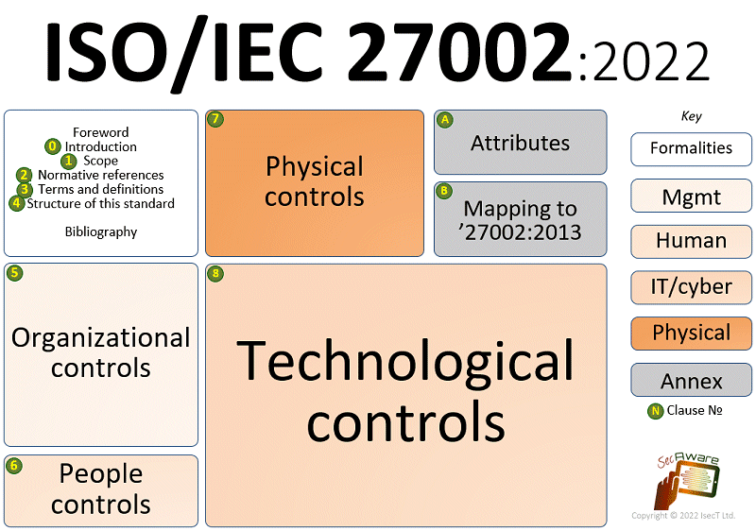
3.1 Physical Security Standards
3.1.1 ISO 27002:2022
Clauses and Controls
Secure Areas
Physical Entry Control
Working in Secure Areas
Equipment Security
Equipment Maintenance
Off-premise Equipment Security
Secure office, Rooms, Facility
External/internal Threats
Secure Disposal or Re-use Equipment
Removal of Property
Control Public Access
Delivery/Loading area access
Equipment Siting and Protection
Supporting Facilities
Physical Security Perimeter
Cabling Security

Slide 7
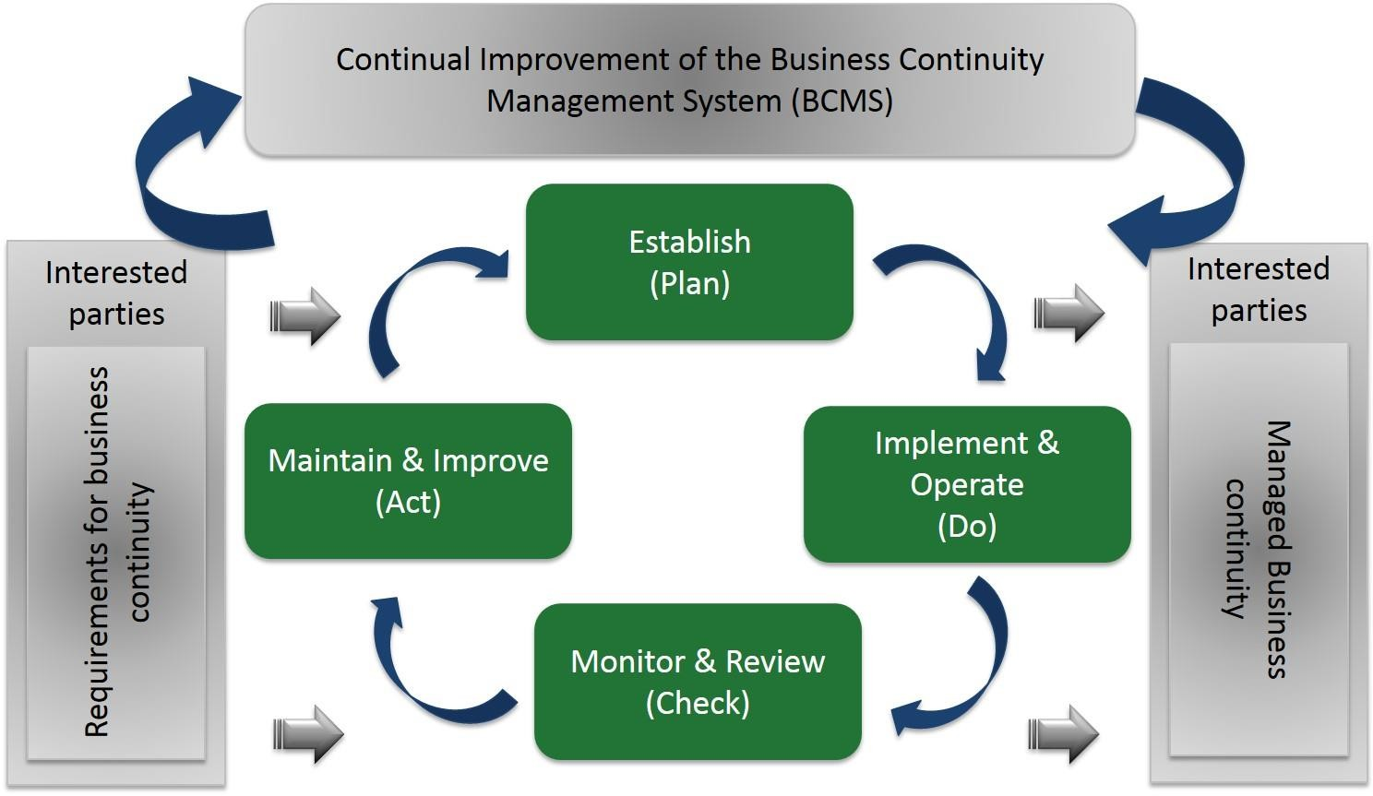
3.1 Physical Security Standards
3.1.2 ISO 22301:2019
“Security and resilience – Business continuity management systems – Requirements”
management system standard published by International Organization for Standardization requirements
Relates to
plan, establish, implement, operate, monitor, review, maintain and continually improve
protect against, reduce the likelihood of occurrence, prepare for, respond to, and recover from disruptive incidents when they arise
applicable to all types of organization or parts

Slide 8
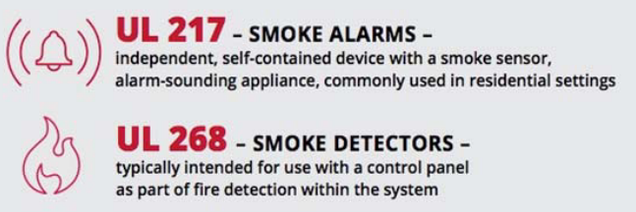
3.1 Physical Security Standards
3.1.3 UL Standard 217
“Safety smoke alarms”
Relates to
Safety clauses for Electronically operated Smoke Alarms (single / multiple or open / closed locations)
Provides guidelines → Certification, Validation, Testing, Inspection, Audit, Advising, Training
Types of Alarms
Single Station – power audible alarm due to excessive heat, smoke from self-contained units
Multiple Station – interconnected station alarms on doors using battery
Recreational Vehicles & Boats – ANSI/UL 217 for environmental tests

Slide 9
3.1.4 Sectorial Standards (industry / domain based)
BFSI – Banking (B), Financial Services (FS), Insurance (I) → Sarbanes-Oxley (SOX) 302/404 Sections for Public orgs
Healthcare – HIPPA (Health Insurance Portability and Accountability Act) for Physical Security guidelines
applies to businesses that work with companies that create, receive, transmit, store, or maintain protected health information (PHI)
Digital Information Security in Healthcare Act (DISHA)
Telecom –
11 domains in ISO Standard
Covers Physical, Network, Systems, Security Governance, Incident Compliance & Management, Business
Continuity
Payment Card : Payment Card Industry Data Security Standard (PCI DSS)
12 requirements
4 compliance levels
Government Sector –
HDSPD-12 standard for employees and contractors for Personal Identity Verification (PIV)
Required for authentication
Interoperability between government agencies and departments
Notes:
Homeland Security Presidential Directive 12 (HSPD-12)

Slide 10
3.2 Indian perspective
Cyber Attacks → 1st copy of legislation was released on 2000 → India IT Act, amended in 2008
Deals with cybercrime and electronic commerce
Section 69A authorities have the power of "interception or monitoring or decryption of any information through any computer resource"
Regulations on Physical Security –
Restrictions on data processing & collection
Individuals aware – data collected – why, reason, recipient, contact
Rights of Correction (modification) and Access
Individuals provided review rights
3rd Party Disclosure
Possession of an org may be given to the 3rd party with org’s consent
International Data Transfers –
Can only send data to other location if same level of data protection is available
Transfer only after ‘green flag’ by government
Transfer must involve consent of data provider

Slide 11
3.2 Indian perspective
Digital Personal Data Protection Act, 2023
legal framework to regulate digital personal data collection, usage, processing, and storage
“Data privacy vs Data Protection”
DPDP act (egazette.gov.in)

Slide 12
3.3 Compliance
State of being in accordance with the established guidelines, specifications or process
Physical Security → data theft / damage
To ensure successful compliance –
Create map of activities, operations, process
Visibility of access points
Sub-divide organization into different security zones
Establish Physical Security processes, revoking/allow
Establish mechanisms for Identification, Authentication, Authorization
Inventory
Authorize Security procedure
Adequate security guards
Supporting Resources to gather info / process /guidelines –
Internal – departments, publications, security program
External – peer organizations, local security professionals – share programs, info on issues/trends

